Slide 1

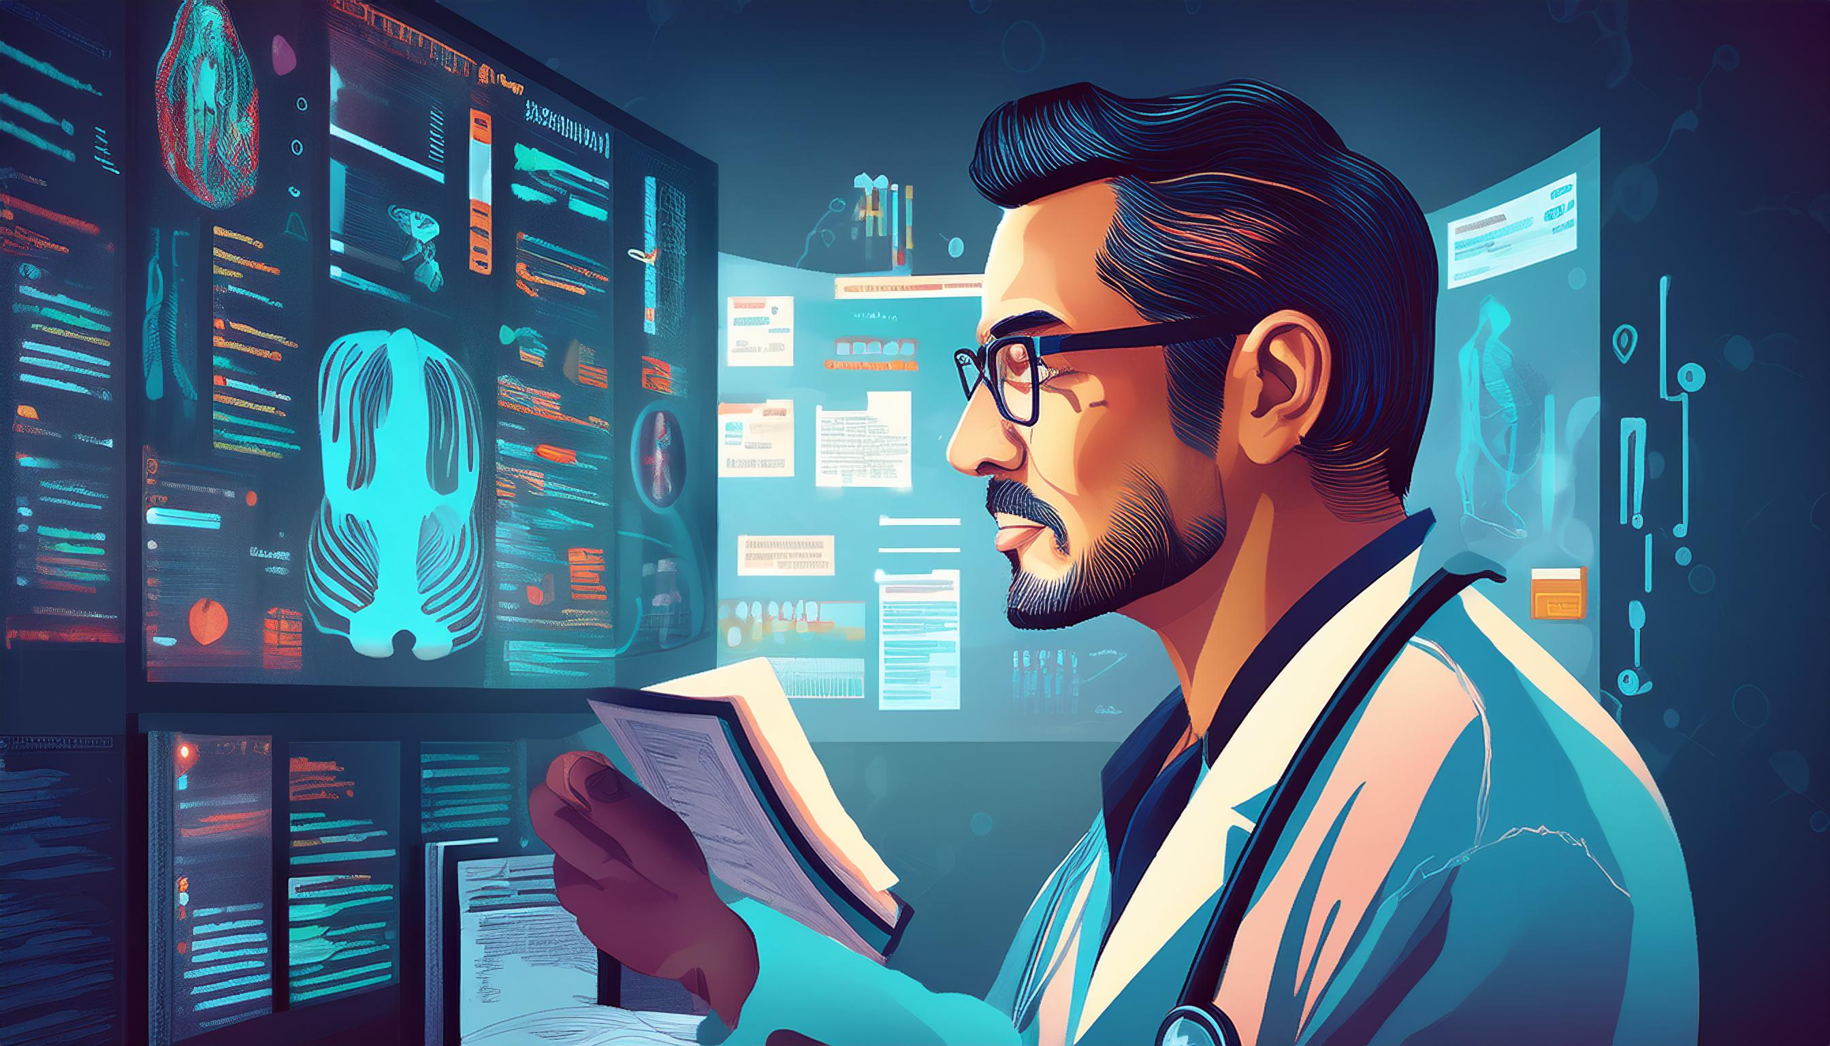
medical data extraction

Slide 2
STUDENT PROFILE
Name | Dharmike Baria
Enrollment No. | 22082701033
Group No. | 14
Course | Bsc.IT Data Science (Sem 6th)
College Name | Department of Computer Science
University Name | Ganpat University
Academic Year | 2025
Internal guide | Pravina patel

Slide 3
INTRODUCTION
Objective:
Automate the extraction of patient details and prescription data from medical documents using Optical Character Recognition (OCR).
Background:
Medical documents contain crucial patient data, often stored in non-digital formats.
Manual data entry is prone to errors, leading to incorrect record-keeping and slow claim processing.
OCR, combined with AI-driven preprocessing, can enhance accuracy and reduce time spent on manual data extraction.

Slide 4
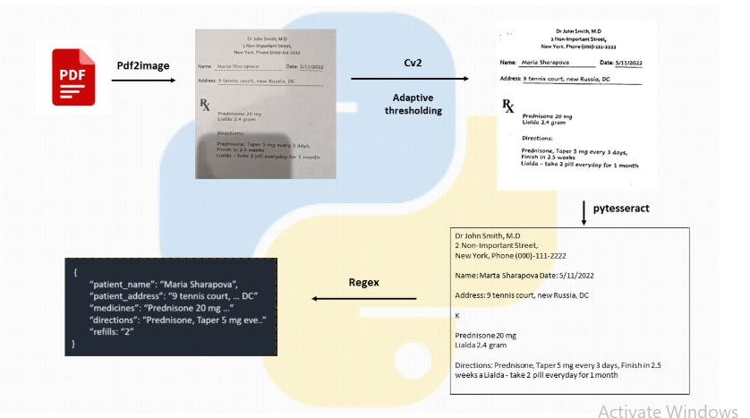
INTRODUCTION
executed

Slide 5
PROBLEM STATEMENT
Current Issue:
Health insurance companies manually process patient details and prescriptions for claim approvals.
The manual process is slow, labor-intensive, and error-prone.
During high-demand periods (e.g., pandemics), manual data extraction becomes infeasible.
Challenges:
Variability in document formats and font styles.
Presence of handwritten text, which is difficult to digitize accurately.
Noisy backgrounds and unclear scans reducing OCR efficiency.
Need for Automation:
Reduce manual effort and improve efficiency.
Meet the 24-hour deadline imposed by insurance companies for claim processing.

Slide 6
OBJECTIVE
Develop an OCR-based automated solution to extract text from scanned medical documents.
Key Goals:
Ensure high accuracy in extracting patient and prescription details.
Minimize human intervention while maintaining verification mechanisms.
Enable integration with insurance claim processing systems for real-time application.

Slide 7
SCOPE
Industries Benefited:
Healthcare: Digitalization of patient records, easy retrieval of medical histories.
Insurance: Faster and more efficient claim processing.
Data Analytics: Structured data extraction for trend analysis and predictions.
Application Areas:
Hospitals and clinics for automated document management.
Insurance providers to streamline claims.
Pharmaceutical industry for prescription processing.

Slide 8



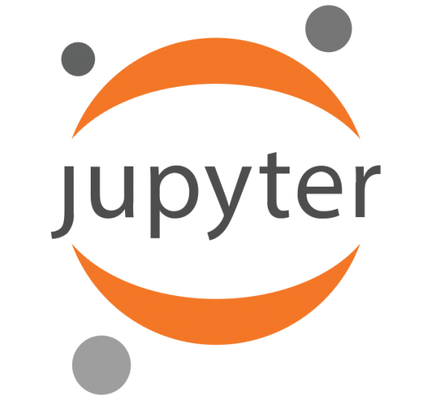
TECHNOLOGY USED
Version 10
Version v7.2.1
Windows 10
Juypter notebook
Python libraries
pdf2image==1.10.0
pytesseract==0.3.0
opencv_python==4.1.2.30
numpy==1.19.4
pandas==0.25.3
Pillow==7.0.0
Fastapi [all]
pytest==6.2.2
Pycharm
Version 2024.3.5

Slide 9
DATA COLLECTION
Sources:
Scanned medical prescriptions from hospitals and clinics.
Electronic Health Records (EHRs) converted to image-based formats.
Format:
PDF and image-based documents.
Includes a mix of printed, handwritten, and digital text.

Slide 10
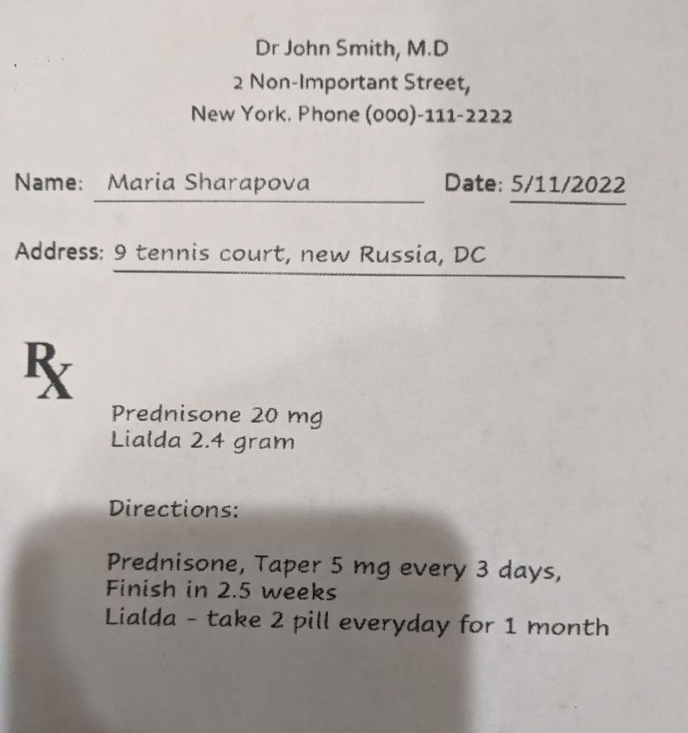
DATA COLLECTION

Slide 11
Exploratory Data Analysis
Challenges in Raw Data:
Variability in fonts and text alignment.
Presence of shadows, noise, and distortions in scanned images.
Preprocessing Techniques:
Grayscale Conversion – Reducing color complexity.
Thresholding (Normal & Adaptive) – Improving text clarity.
Noise Reduction – Enhancing OCR performance.
Insights from EDA:
Identifying common text structures in medical documents.
Understanding OCR failure cases due to poor image quality.

Slide 12
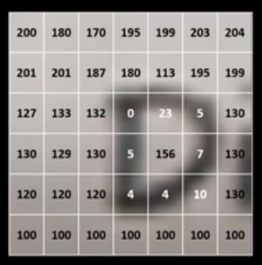
Exploratory Data Analysis

Slide 13
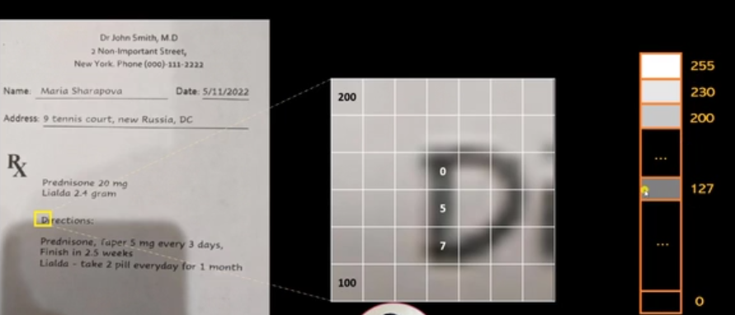
Exploratory Data Analysis

Slide 14
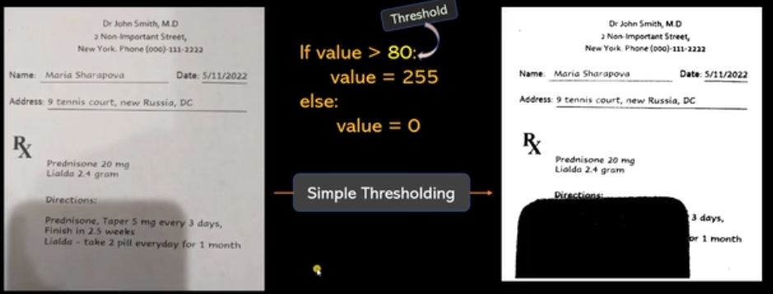
Exploratory Data Analysis

Slide 15
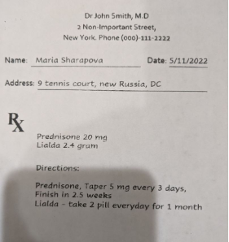
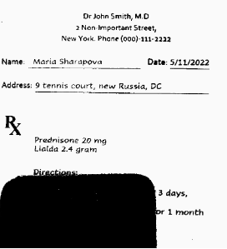
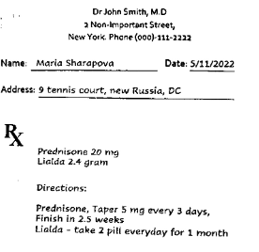
Exploratory Data Analysis
Original Image | Thresholded Image | Adaptive Filtered Image

Slide 16

Methodology
Convert PDF to Image using pdf2image.
Preprocess the image using OpenCV (Grayscale, Thresholding, Noise Reduction).
Extract text using Tesseract OCR.
Use Regular Expressions (RegEx) to extract relevant data.
Develop a FastAPI backend to process data.
Build a Streamlit-based frontend for user interaction.

Slide 17
Model Developmnt
OCR Engine:
Tesseract OCR for text extraction.
Backend Framework:
FastAPI for handling API requests.
Data Processing:
Regular Expressions for structured information retrieval.
Testing Approach:
Pytest-driven development.
Deployment:
Local execution with API-based integration.
Can be extended to cloud-based services for scalability.

Slide 18
Evaluation
Metrics Used:
OCR Text Recognition Accuracy.
Precision and Recall for extracted fields.
Error Rate Reduction after preprocessing.
Validation Methods:
Manual verification of extracted text.
Comparing extracted values with ground truth data.
Performance Improvements:
Preprocessing improved OCR accuracy by 25%.
Adaptive thresholding reduced text misinterpretation.

Slide 19
Result & Analysis
Key Achievements:
Successfully extracted patient details and prescriptions.
Reduced manual processing time by 30 seconds per document.
Improved data accuracy through preprocessing and adaptive thresholding.
Challenges Faced:
Issues with handwritten text recognition.
Some data loss in low-quality scans.
Need for better model tuning to handle different formats.
Comparison of Extracted vs. Actual Data:
OCR successfully extracted 85% of printed text correctly.
Handwritten text accuracy was lower, requiring additional post-processing.

Slide 20
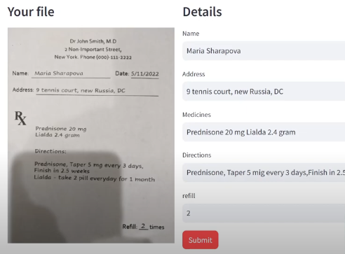
Result & Analysis

Slide 21
Conclusion
Impact:
Automates the data extraction process, reducing manual errors.
Speeds up claim processing for insurance companies.
Improves scalability for handling large datasets.
Future Enhancements:
Deep learning-based OCR models for better accuracy.
Cloud deployment for real-time document processing.
Enhanced UI with real-time corrections and validation.

Slide 22
References
Libraries & Tools Used:
OpenCV, Tesseract, FastAPI, Pdf2Image, RegEx, Pytest, Postman.
Related Works:
Tesseract OCR Research Papers.
FastAPI Documentation.
Codebasics Python Course (Link).
AI-powered OCR techniques from Google AI research.

Slide 23
Thank You!

